Slide 1



Masters in Engineering and Data Science
ADSS - Analytical Decision Support Systems Report
Aircraft Landings Scheduling
GRUPO B3
Bruno Fernandes
Hugo Filipe Silva Abelheira
Tiago Araújo Coelho

Slide 2

Agenda
Introduction
Performance Metrics
Problem Formulations
MIP
CP
MIP
Result Analysis
Parameters & Decision Variables
Mathematical Formulation
Results
CP
Visualizations
Parameters & Decision Variables
Conclusion
Mathematical Formulation
Search Strategies
Decision, Branching and Value Strategies
Hint

Slide 3
Introduction

Slide 4

Introduction
Aircraft landing scheduling is crucial for efficient airport operations;
Single and Multiple runways scenarios;
Mathematical Programming (MP) and Constraint Programming (CP) to optimize landing schedules and handle complex constraints;
The project evaluates the effectiveness of these methods in improving airport efficiency and handling real-world complexities.

Slide 5
Problem Formulations

Slide 6
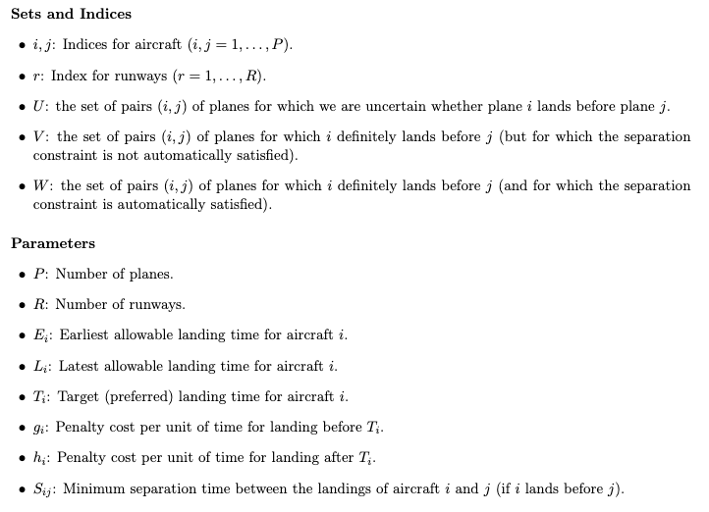
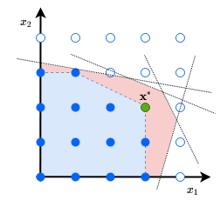
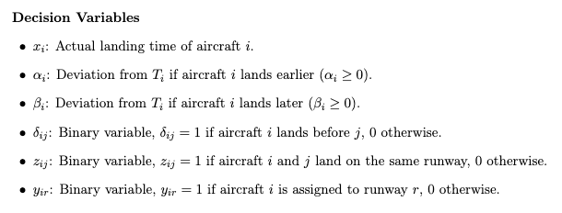
MIP - Parameters & Decision Variables

Slide 7
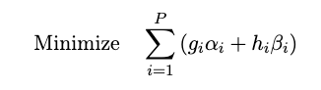
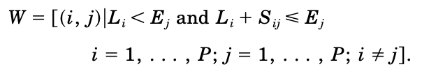
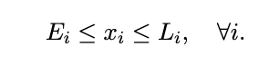
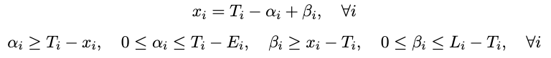
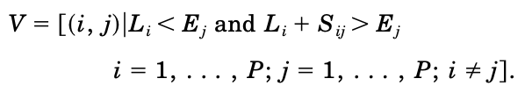
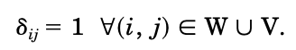
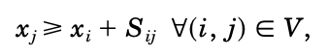
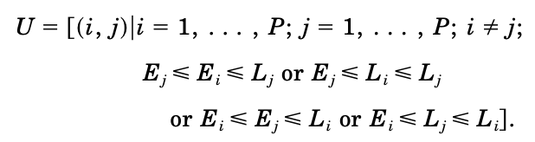
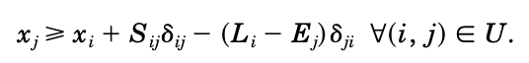
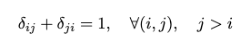
MIP - Mathematical Formulation
Objective Function:
Sets:
Constraints:
Time Window Constraints:
Deviation Definition:
Separation Constraints:
Variable Domains:
Landing Order:

Slide 8
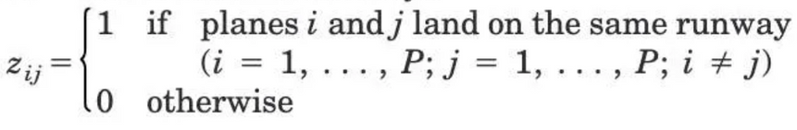
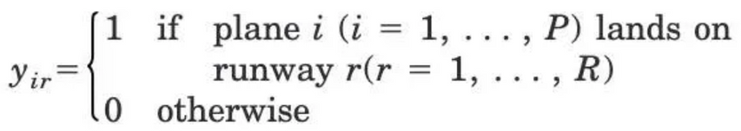
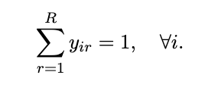
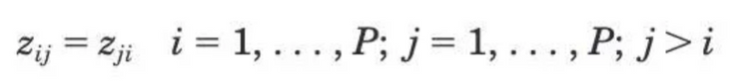
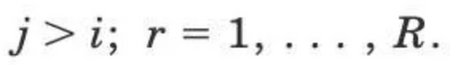
MIP - Extension for Multiple Runways
New Decision Variables:
New Constraints:
replaced by

Slide 9
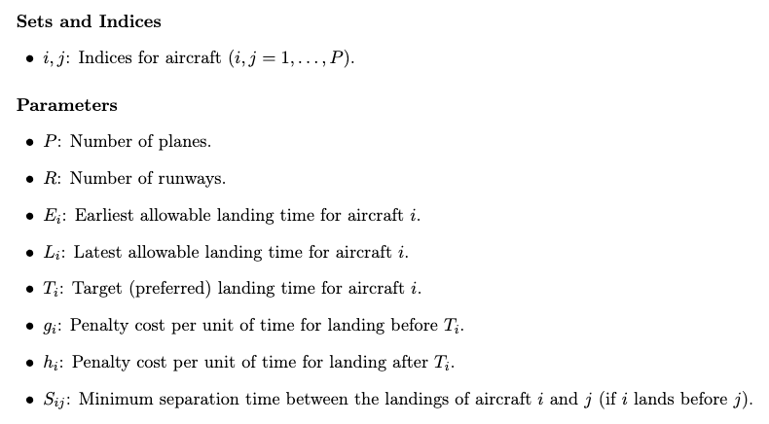
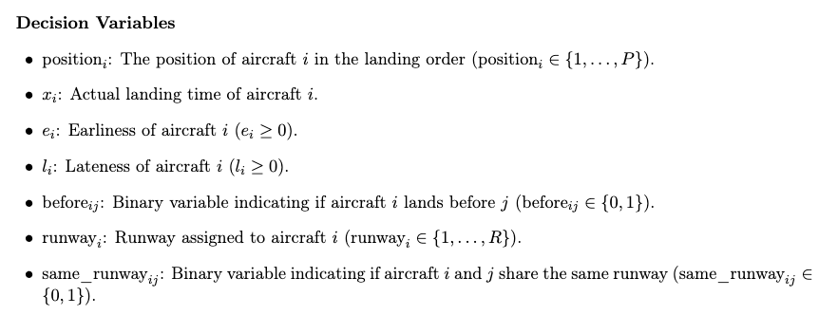
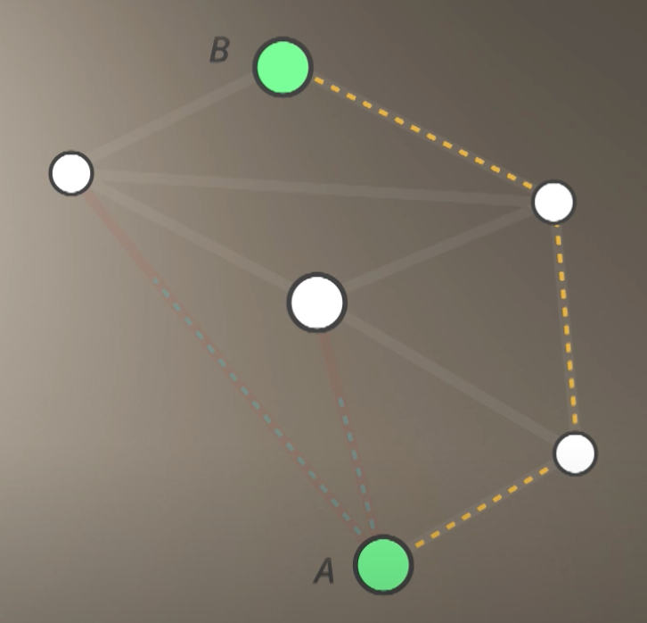
CP - Parameters & Decision Variables

Slide 10
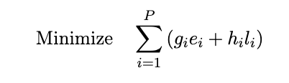
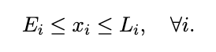
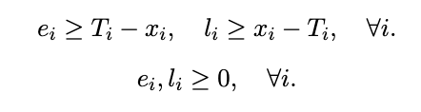
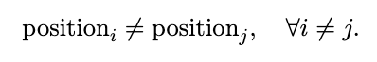
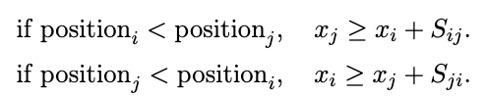
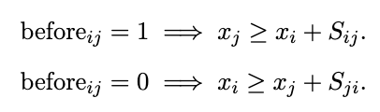
CP - Mathematical Formulation
Objective Function:
Constraints:
Time Window Constraints:
Deviation Definition:
Landing Order:
Separation Constraints:
Binary Variable:

Slide 11
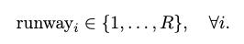
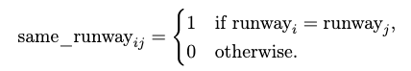
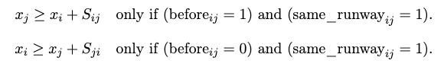
CP - Extension for Multiple Runways
New Variables:
New Constraints:
Conditional Separation Based on Runway:

Slide 12
Search Strategies

Slide 13
Variable, Branching and Value Strategies
Variable Strategies
Branching Strategies
Value Strategies
Branching strategies dictate how the search tree is explored.
Variable selection strategies help determine which variables should be assigned values first during the search process.
Value selection strategies decide which values should be assigned to a selected variable.

Slide 14
Hint
Guidance for Solver: Hints guide the solver by fixing a variable or directing the exploration process;
Runway Allocation: In our case, the hint fixes the allocation of one runway at the start, narrowing the search space;
Optimization of Search: The use of hints helps optimize the search

Slide 15
Performance Metrics

Slide 16

Performance Metrics - MIP
In MIP, performance metrics assess solver efficiency, solution quality, and computational requirements to ensure effective model design
Execution Time: Time taken by the solver to find an optimal solution or declare infeasibility;
Number of Variables: The total number of decision variables;
Number of Constraints: Defines the complexity by the number of rules the solution must satisfy;
Total Penalty: Objective function value that represents cost, profit, or performance indicators.

Slide 17
Performance Metrics - CP
In CP, performance metrics evaluate the solver’s efficiency, solution quality, and the handling of combinatorial problems, highlighting the effectiveness of constraint handling and search strategies
Execution Time: Time taken to solve the problem;
Solution Status: Indicates if an optimal solution was found;
Number of Conflicts: Tracks conflicts when partial solutions violate constraints;
Number of Branches: Total branches explored in the search tree;
Best Objective Bound: The best bound achieved during search;

Slide 18
Result Analysis

Slide 19
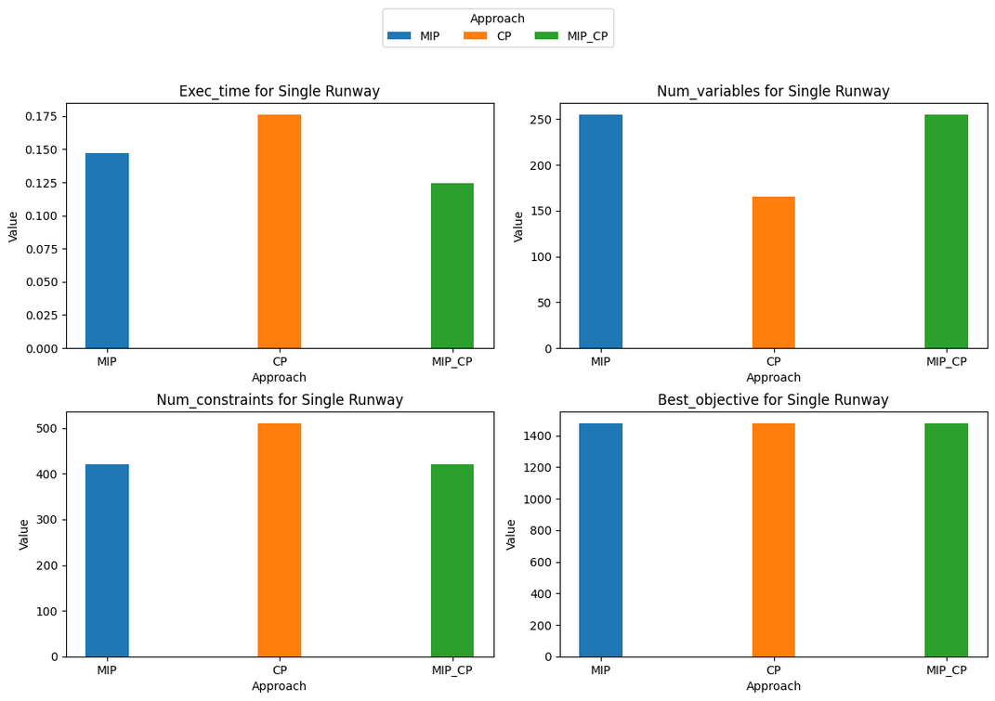
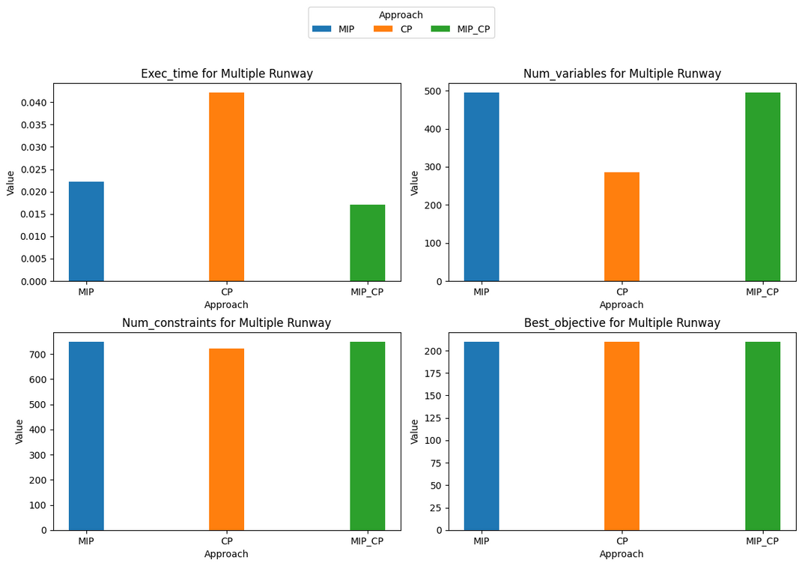
Comparison between different Approaches

Slide 20
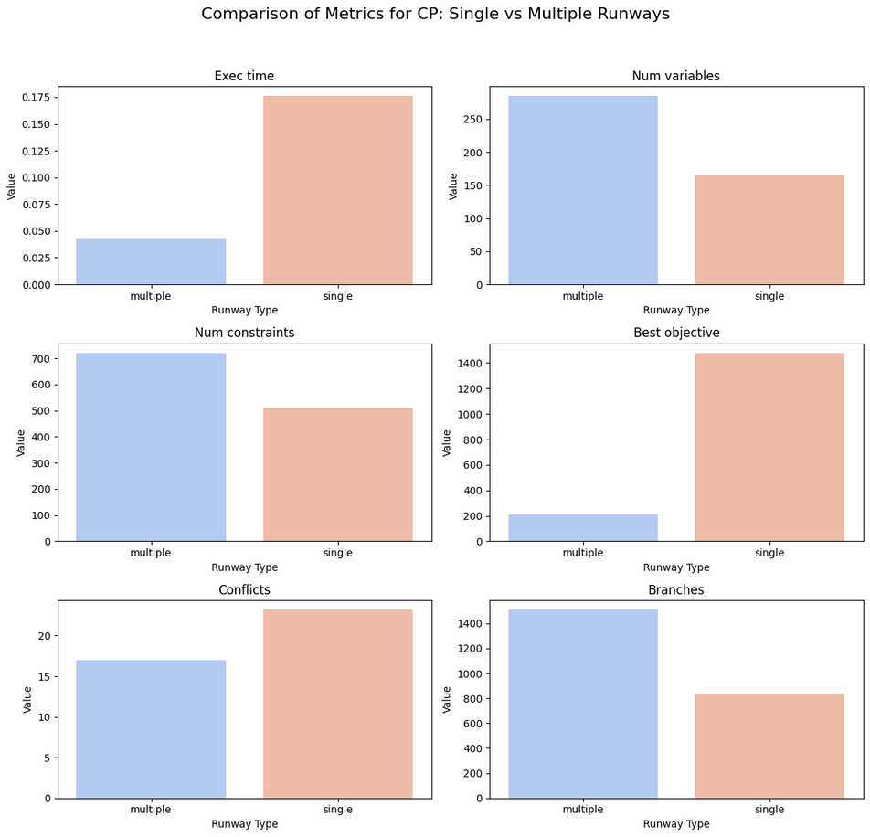
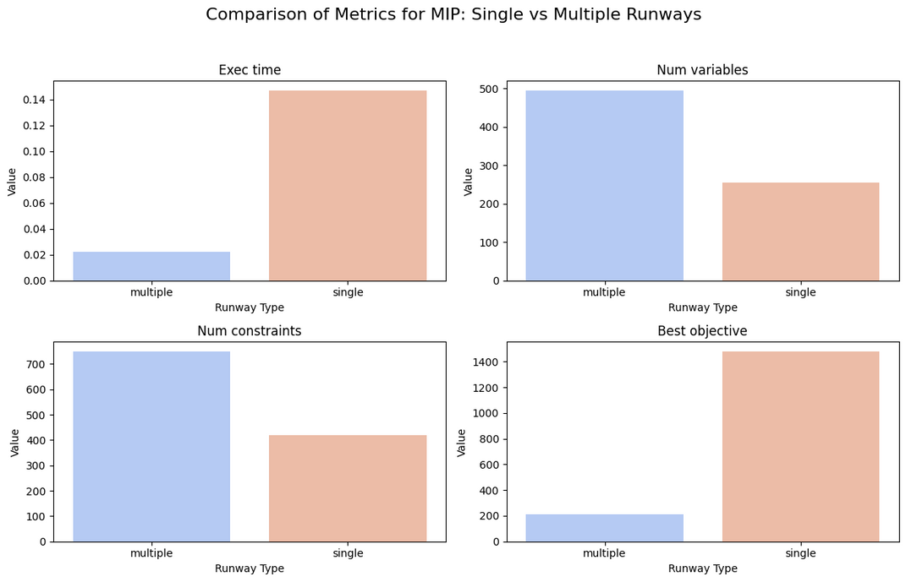
Single vs Multiple Runways

Slide 21
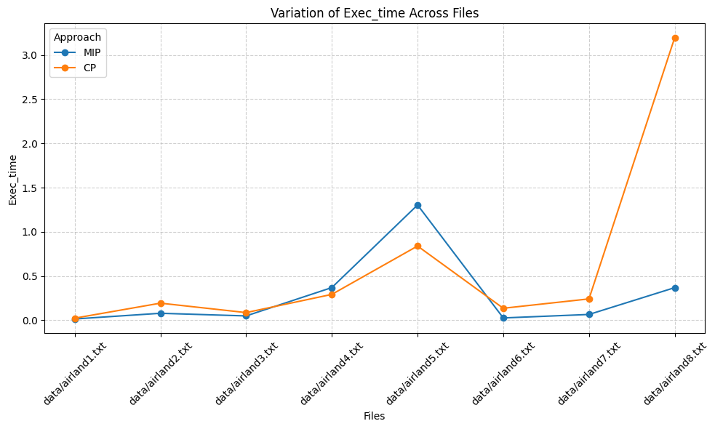
Variation of Execution Time

Slide 22
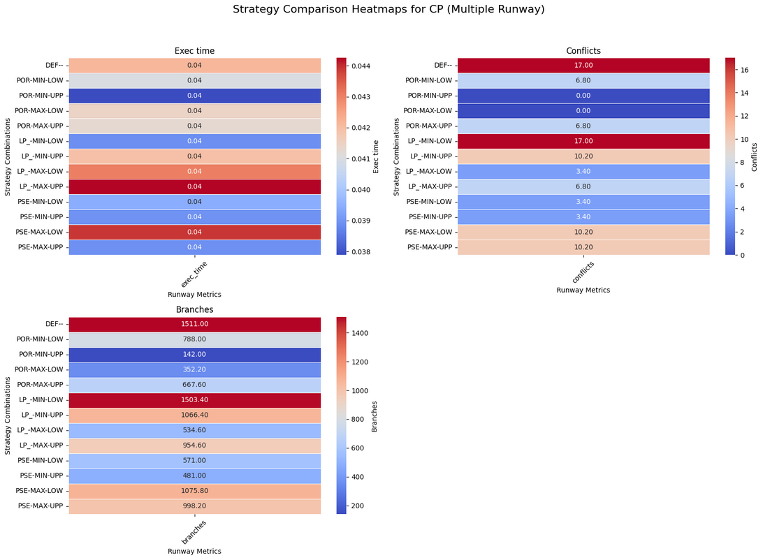
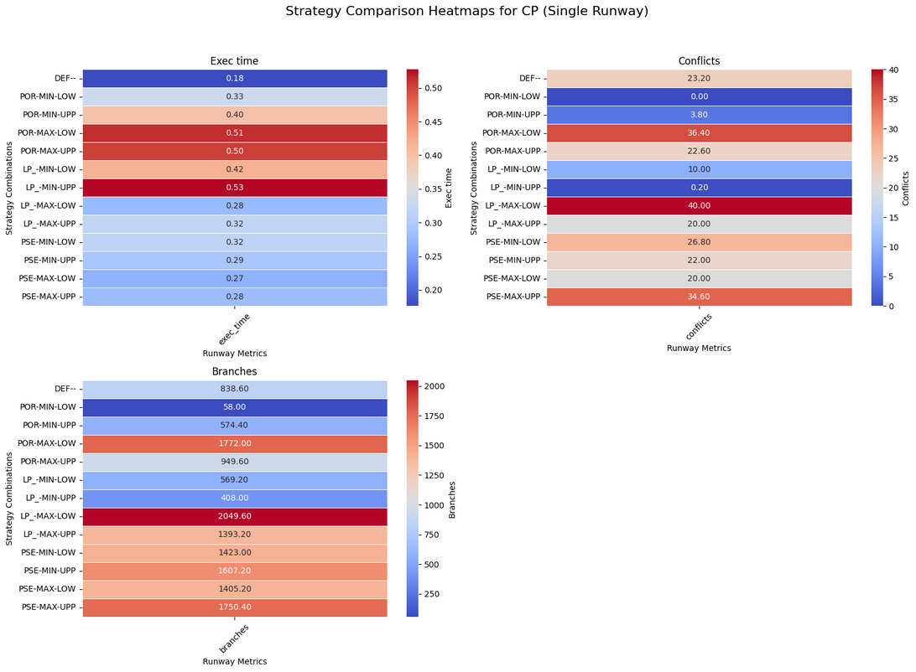
Strategies Combination

Slide 23
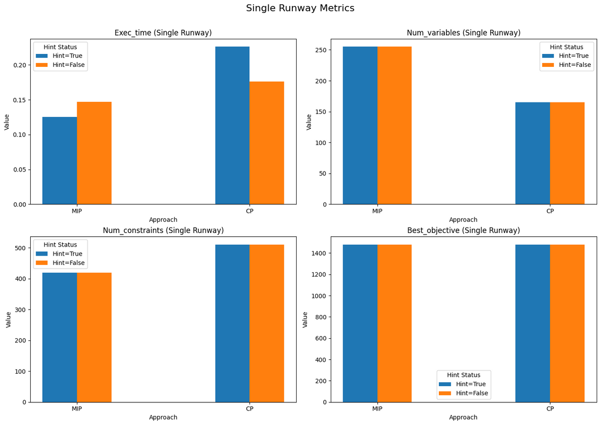
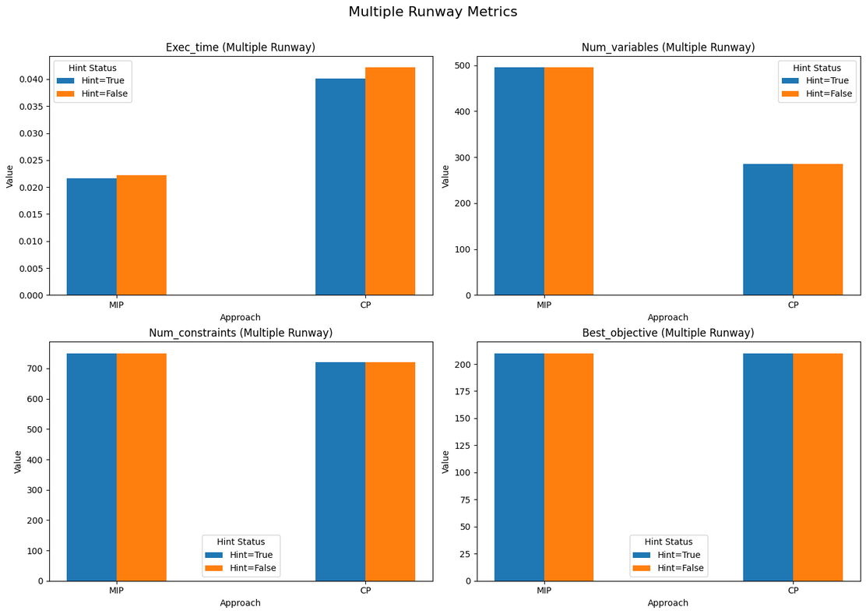
Hint Impact

Slide 24
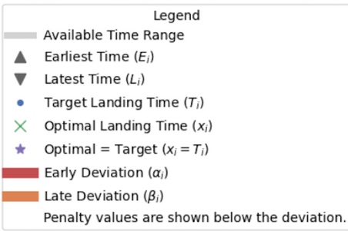
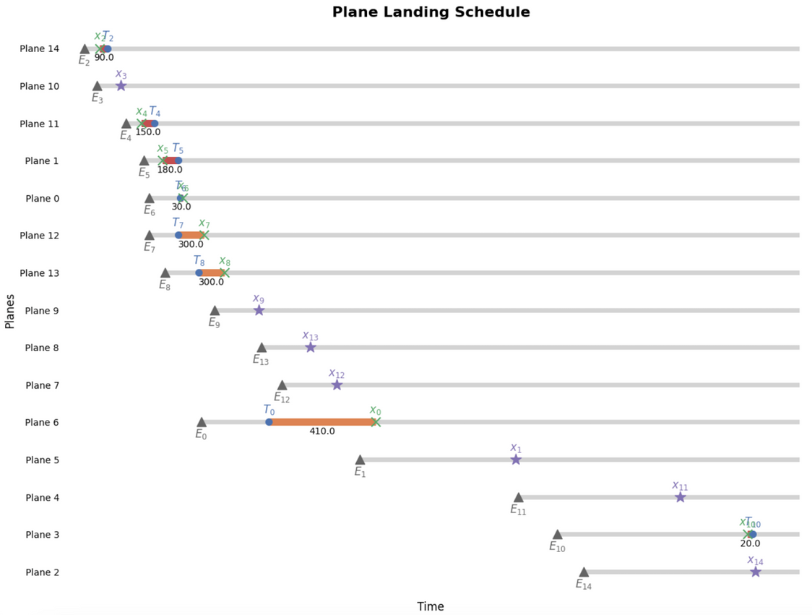
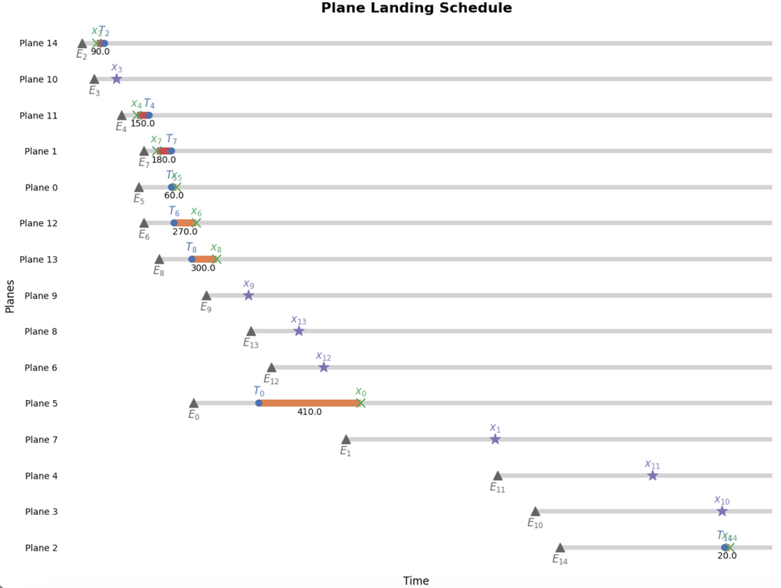
Solution Visualization
CP
MIP

Slide 25
Conclusion

Slide 26
Conclusion
MIP, CP, and hybrid MIP_CP approaches were evaluated to solve the Aircraft Landing Scheduling Problem;
MIP proved efficient for simpler problems, offering faster execution times;
CP handled complex constraints effectively but required more computational resources;
The hybrid MIP_CP approach combined MIP’s speed with CP’s flexibility, achieving balanced results;
In multiple-runway scenarios, CP excelled due to increased flexibility, reducing conflicts and execution times;
Strategies like branching and hints significantly improved solver efficiency by narrowing the search space;
The choice of method depends on the problem’s complexity, with CP suited for intricate challenges, MIP for simpler cases, and hybrid methods offering versatility.

Slide 27
Masters in Engineering and Data Science
ADSS - Analytical Decision Support Systems Report
Aircraft Landings Scheduling
GRUPO B3
Bruno Fernandes
Hugo Filipe Silva Abelheira
Tiago Araújo Coelho

